Slide 1
Checking and securing understanding of multiples of 10
Task A: Using powers of 10 to simplify calculations
1) Match the calculation with the calculation using exponential form.
200 × 400
8 × 10
200 × 4000
8 × 10⁵
2 × 40
8 × 10⁴
8000 × 1000
8 × 10⁶
2) Match the calculation with the calculation using exponential form.
200 × 600
12 × 10⁴
200 × 6000
1.2 × 10²
2 × 60
12 × 10⁵
3000 × 4000
1.2 × 10⁷
3) Fill in the missing numbers. Make sure to show your working out.
a) 9000 × 100 = 9 × 10⬚
b) 300 × 250 = 75 × 10⬚ = 7.5 × 10⬚
c) 4000 × 1500 = 60 × 10⬚ = 6 × 10⬚

Slide 2

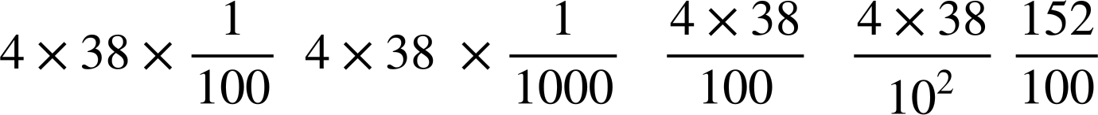

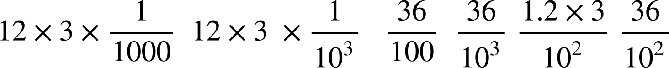
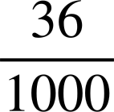
Checking and securing understanding of multiples of 10
Changing compound interest rates
4) Put a tick next to the calculations which are correct and create two of your own correct calculations using powers of 10.
240 × 10
24 × 10³
24 000
8 × 3 × 10³
2.4 × 10⁴
12 × 2 × 10³
Task B: Using equivalent fractions to simplify calculations
1) Identify the equivalent calculations to 3.4 × 9.3
a
b
c
d
e
2) Identify the equivalent calculations to 0.4 × 3.8
a
b
c
d
e
3) Put a tick next to the calculations which are correct and create two of your own correct calculations using powers of
________
1.2 × 0.03
________

Slide 3
Checking and securing understanding of multiples of 10
4) Create your own calculation and six equivalent calculations using powers of
________
________
________
________
________
________
Mathematics in Education and Industry
v2.3

